Slide 1
Conformational Sampling
Rohit Shankar

Slide 2
Steps in Project
1. Create library using IBM with benzylic tribromide + peptide chain + thiol. – Completed
2. Use Monte Carlo Multiple Minimum for conformational sampling.
3. Modify format of MCMM output to match Protein Data Bank and overlay cyclic peptides with protein backbones. Find low RMSD values.
4. Align with Kirtzer hot loops to find possible mimics

Slide 3
Schrodinger Macro model
The software maestro was used to perform the conformational sampling.
All the .mols from the library generated in the previous step were loaded into the software. Unique conformers are generated using MCMM.

Slide 4
Settings for Conformational Sampling
Settings including energy to save and max steps/structures to save were based on amount of alanine in structure.
The minimum energy for smallest ring in the library was 62.8 kJ/mol. For each extra alanine in a ring 2.092 kJ/mol or 0.5 kCal/mol was added to the energy.
The max steps started at a minimum of 10,000 and 2000 was added per extra alanine.

Slide 5
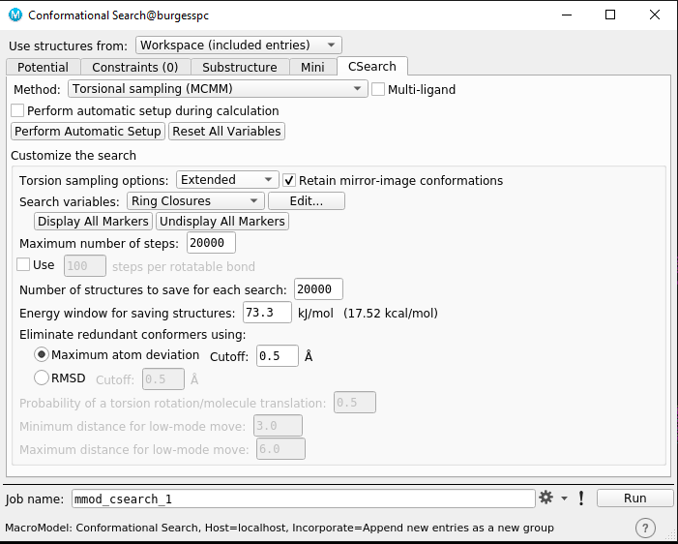

Slide 6
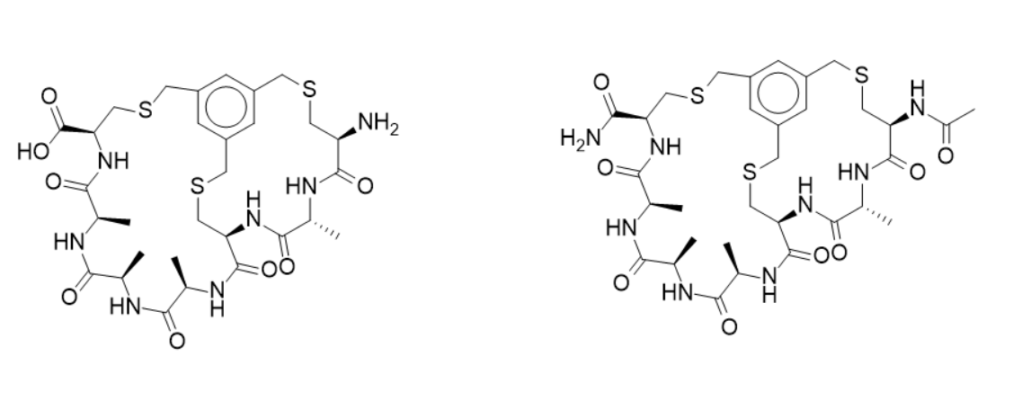
Changing Terminal functional group
Since the compounds after syntheses rarely have free terminal groups, they needed to be modified. The COOH terminus was changed to CONH2 and NH2 terminus was changed to NH-CO-CH3.
This was done by modifying the script which originally made the library of peptides

Slide 7
Current Progress
Currently 180/640 tasks are loaded finished.
All the conformational sampling tasks should be loaded in a few days.

